Slide 1
Mini Popper | Colt poppers | Pepper poppers | Plates | Wall feet
2 | 6 | 0 | 0 | 66
Bay | Stage | Target Type | Count | NS | Total | Hard Cover
A2 | Bring It | USPSA | 12 | 2 | 14 | 1 Tux 1 Left Diag
A1 | CM 22-04 | USPSA | 2 | 1 | 3 | 1 Left Diag 1 Right Diag
B1 | Step | USPSA | 11 | 2 | 13 | 1 Tux 1 Left Diag
B2 | Let's Make a Deal | IPSC | 8 | 3 | 11 | 1 Tux 1 Left Diag 1 Right Diag
B3 | Short Shorts | USPSA | 5 | 1 | 6 | 1 Tux
B4 | Daddy Wasn't There | IPSC | 8 | 1 | 9 | 1 Left Diag

Slide 2
Prop | Stage
Door | Stage 4 (B2)
Swinger | Stage 4 (B2)
2 swingers | Stage 6 (B4)
Stomp pad | Stage 6 (B4)

Slide 3

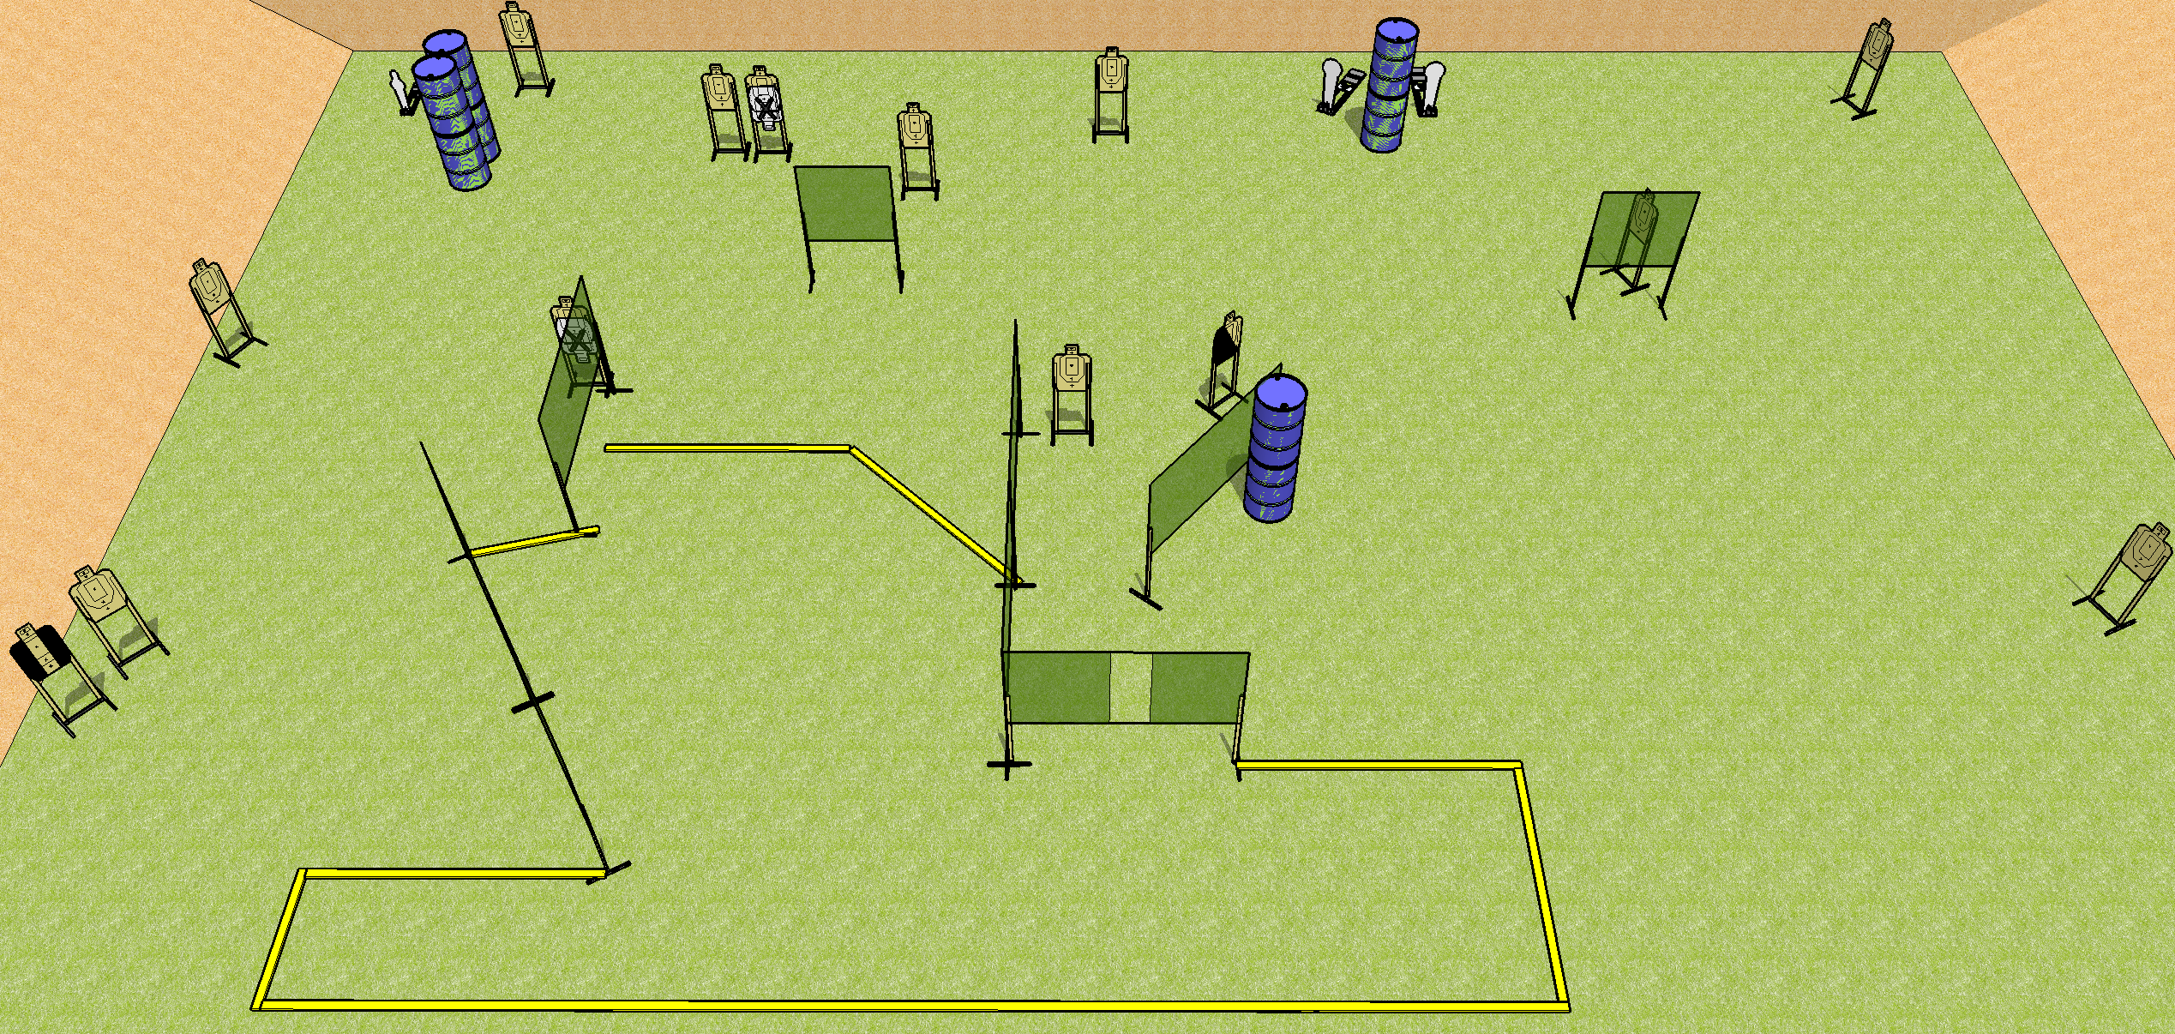
 | Dothan Practical Shooters – USPSA Match Bring It Course Designer : Drew Coleman Bay: A2
Round Count 32 rounds 14 USPSA 3 colt poppers, 1 mini popper
Equipment List 15 wall feet 1 tux, 1 left diag 14 targets (12 + 2NS)

Slide 4
Stage Name
Written Stage Briefing
Scoring: Comstock Rounds: 32
Targets: 14 USPSA, 4 steel
Handgun start position: anywhere inside the shooting area, wrists below belt. Handgun is loaded and holstered.
PCC start position: anywhere inside the shooting area, stock on belt. Loaded carbine is held with both hands, safety on.
Stage Procedure: on the audible start signal, engage targets as they become available from within the shooting area.

Slide 5
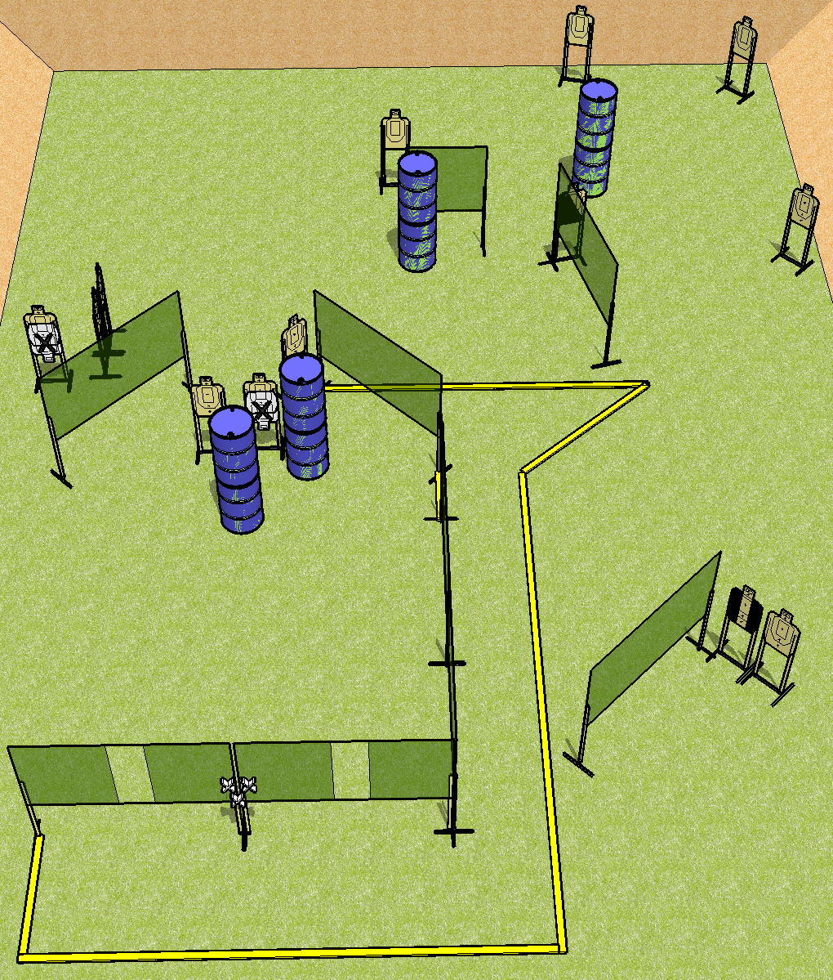
 | Dothan Practical Shooters – USPSA Match Step Course Designer : Drew Coleman Bay: B1
Round Count 26 rounds 13 USPSA
Equipment List 15 wall feet 1 tux, 1 left diag 13 targets (11 + 2 NS)

Slide 6
Step
Written Stage Briefing
Scoring: Comstock Rounds: 26
Targets: 13 USPSA
Handgun start position: hands touching upper set of marks. Handgun is loaded and holstered.
PCC start position: muzzle touching lower mark, stock on belt. Loaded carbine is held with both hands, safety on.
Stage Procedure: on the audible start signal, engage targets as they become available from within the shooting area.

Slide 7
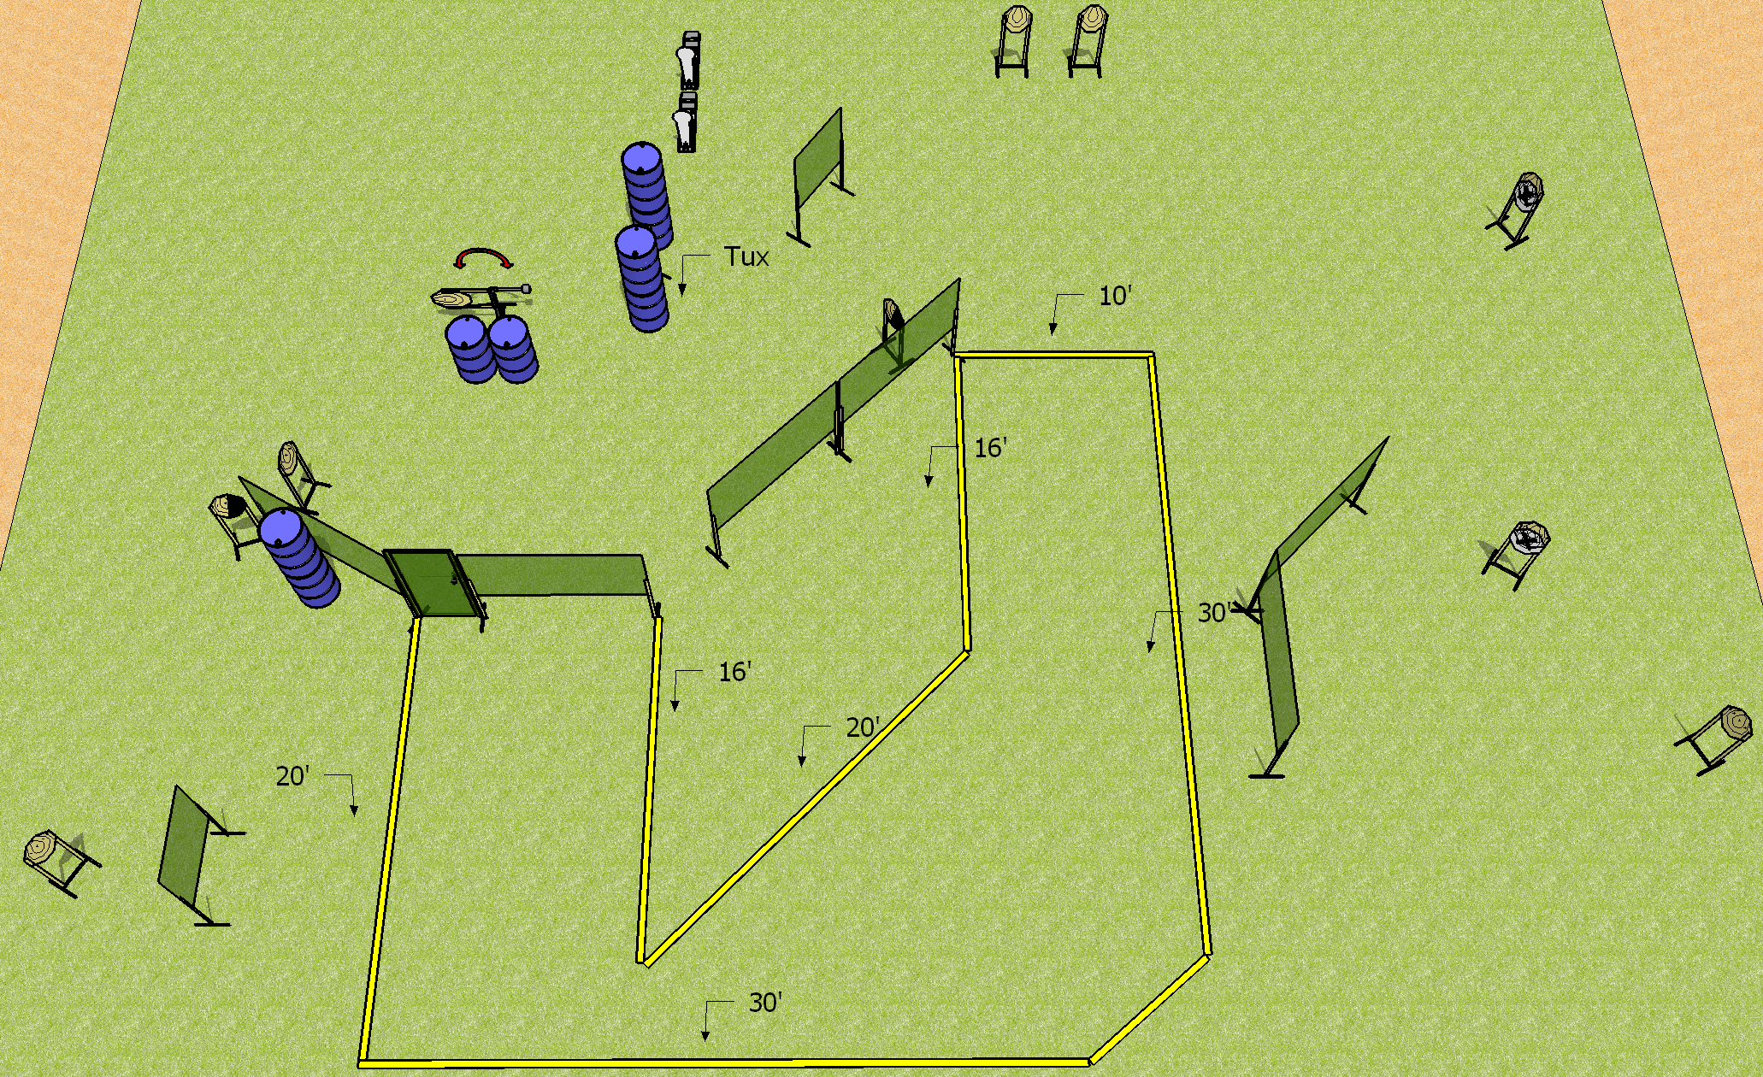
 | Dothan Practical Shooters – USPSA Match Let’s Make a Deal Course Designer : Drew Coleman Bay: B2
Round Count 24 rounds 11 IPSC 2 colt poppers
Equipment List 15 wall feet Door with activator, swinger (swinger will have NS) 11 targets (8 + 3 NS), 1 left + 1 right diag, 1 tux

Slide 8
Let’s Make a Deal
Written Stage Briefing
Scoring: Comstock Rounds: 24
Targets: 11 IPSC, 2 steel
Handgun start position: anywhere inside the shooting area, wrists below belt. Handgun is loaded and holstered.
PCC start position: anywhere inside the shooting area, stock on belt. Loaded carbine is held with both hands, safety on.
Stage Procedure: on the audible start signal, engage targets as they become available from within the shooting area. The swinger is activated by opening the door and remains visible at rest.

Slide 9
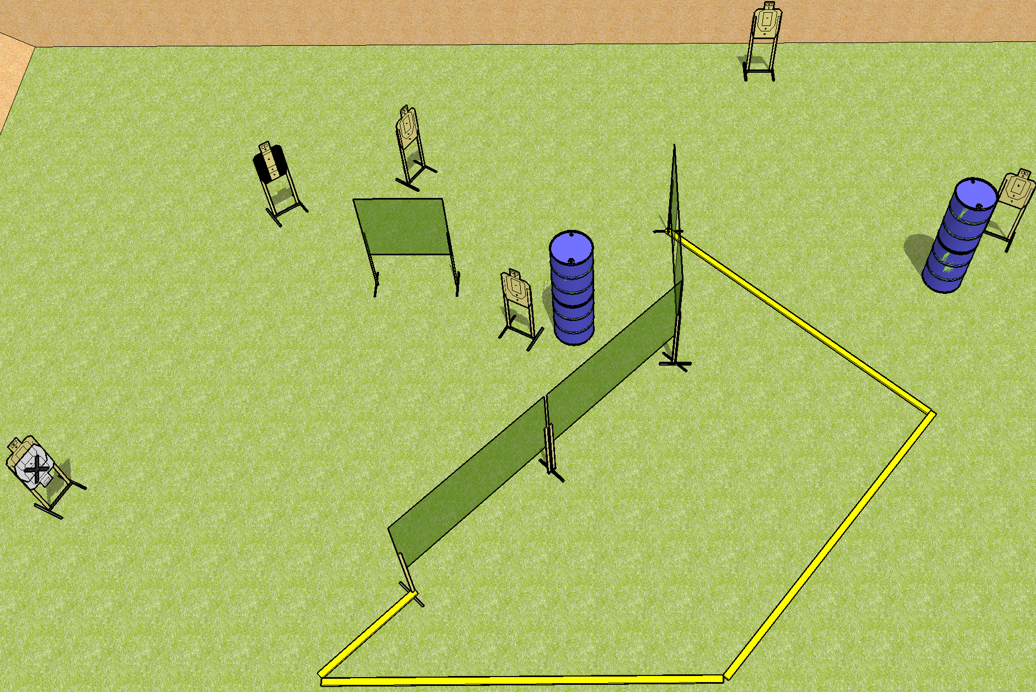
 | Dothan Practical Shooters – USPSA Match Short Shorts Course Designer : Drew Coleman Bay: B3
Round Count 12 rounds 6 USPSA
Equipment List 7 wall feet 6 targets (5 + 1 NS) 1 tux

Slide 10
Short Shorts
Written Stage Briefing
Scoring: Comstock Rounds: 12
Targets: 6 USPSA
Handgun start position: anywhere completely outside the shooting area, wrists below belt. Handgun is loaded and holstered.
PCC start position: anywhere completely outside the shooting area, stock on belt. Loaded carbine is held with both hands, safety on.
Stage Procedure: on the audible start signal, engage targets as they become available from within the shooting area.

Slide 11
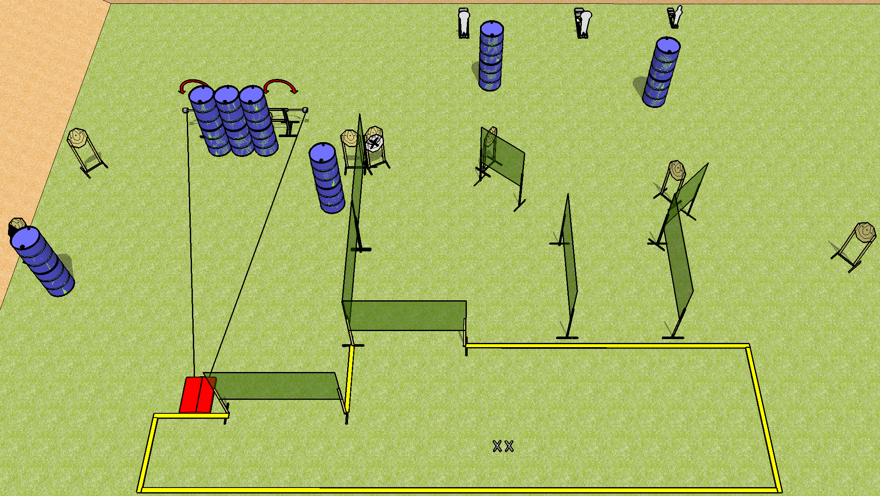
 | Dothan Practical Shooters – USPSA Match Daddy Wasn’t There Course Designer : Drew Coleman Bay: B4
Round Count 30 rounds 9 IPSC 2 colt, 1 mini
Equipment List 2 swingers + stomp pad 14 wall feet 1 left diag 9 targets (8 + 1 NS)

Slide 12
Daddy Wasn’t There
Written Stage Briefing
Scoring: Comstock Rounds: 30
Targets: 9 IPSC, 3 steel
Handgun start position: feet on X’s, wrists below belt. Handgun is loaded and holstered.
PCC start position: feet on X’s, stock on belt. Loaded carbine is held with both hands, safety on.
Stage Procedure: on the audible start signal, engage targets as they become available from within the shooting area. The stomp pad activates the swingers, which remain visible at rest.

